Slide 1
Tab- Menu in Joomla
Unioffices

Slide 2
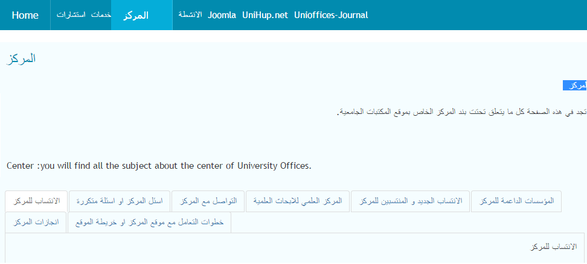
Tab- Menu in Joomla
If you like to have tab access on your article as shown below.

Slide 3
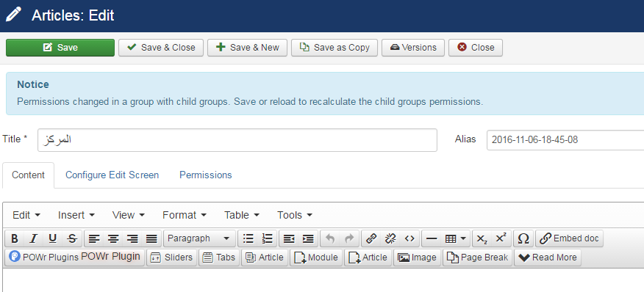
First download a tab.zip from
https://www.regularlabs.com/
Install the tab.zip to your Joomla platform.
Your Article interface will have tab action.

Slide 4
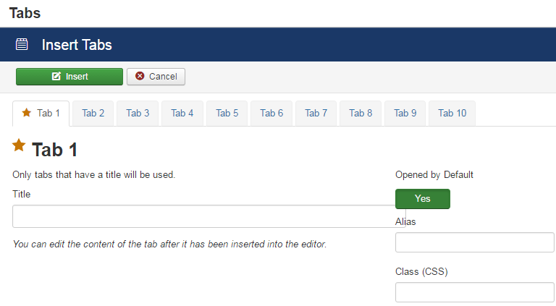
When you press on the tab button, a new window will appears, as shown bellow, and write the name of the tab, and you could have more tab if you like, and when you finish, press insert.

Slide 5
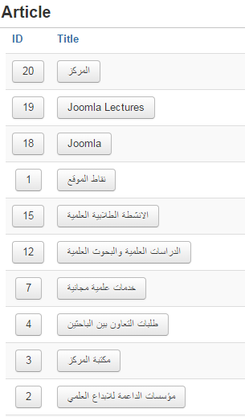
After designing the tabs, set the article to each tab, for each tab press Article.
A new Article window will appears, set the article you wish to set to the tab.

